Slide 1

NEW YORK
PRESENTATION
Louis & Giuseppe

Slide 2
Airbnb NYC 2019 Dataset Overview :
Dataset contains detailed information about Airbnb listings in New York City.
Data from 2019
Main data contained over 40000 rows but had a lot of missing entries.
After cleaning we got we were dealing with just under 300 data points.

Slide 3
RESEARCH ANGLE
Investigate factors influencing Airbnb prices and listing popularity in NYC.
Key Research Questions:
What factors influence the price of Airbnb listings?
How is the relationship between reviews and pricing?
What is the relationship between availability and the neighbourhood group?

Slide 4



HYPOTHESIS
Location
Location influence price and availability
Availability
Availability of AirBNB influence guest opinion
Apt. more reviews
Reviews affect pricing.
Notes:
Listings in Manhattan have higher average prices, High priced listings have a fewer available days, Entire home apartments receive more reviews

Slide 5
OBJECTIVES
1
2
3
Explore the relationship between reviews and listing attributes.
Identify factors influencing Airbnb prices.
Analyze listing availability variations across neighbourhoods

Slide 6
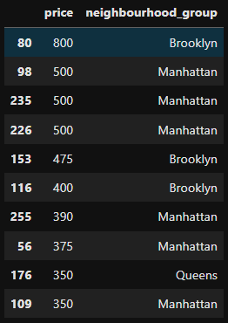
Price Analysis: Top 10 Analysis
Brooklyn had the highest priced AirBnB on the list
In the 10 top priced, Manhattan represented the most followed by Brooklyn and then Queens

Slide 7
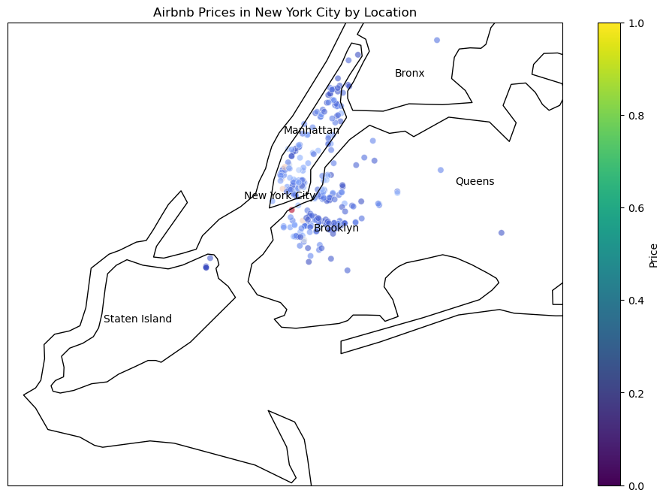
Price Analysis: Neighbourhood Group
The Map Analysis of the whole data seems to reflect the data in the top 10 priced list
Queens on the list seems to be an outlier

Slide 8
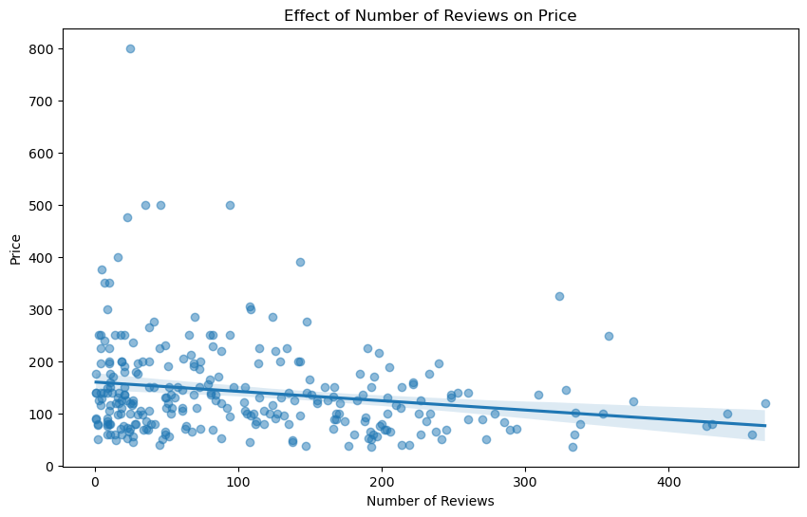
Review Analysis: Hypothesis Testing
Null Hypothesis: Number of reviews affect price
Correlation coefficient: -0.19974524913880048
P-value: 0.0007755905443694049
Reject null. Weak negative correlation between review and price.

Slide 9
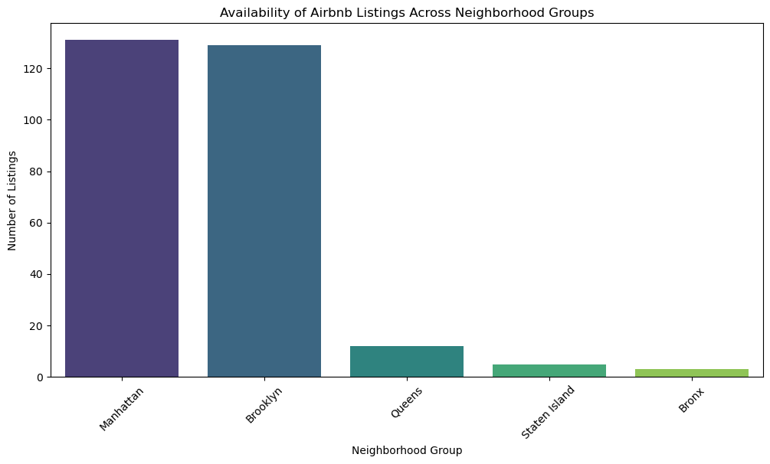
Availability Analysis: Neighbourhood Group
'Manhattan' has the highest number of listings, it might indicate high demand and competition.
'Staten Island' has the lowest number of listings, it might represent an untapped market opportunity for new Airbnb hosts.

Slide 10
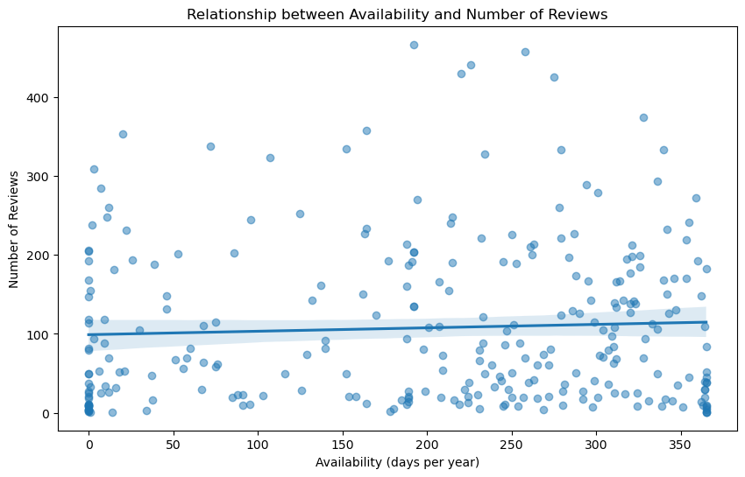
Availability Analysis: Hypothesis Test
Null Hypothesis: Availability influences Reviews
Correlation coefficient: 0.05393388274889865
P-value: 0.36859736982173497
Accept Null hypothesis. Weak positive correlation.

Slide 11
Conclusion
Price Analysis: High Prices: Central Manhattan, particularly around tourist hotspots, shows higher prices. Moderate to Low Prices: Listings in Queens and most of Brooklyn are generally more affordable. Outliers: Some listings in less central areas of Manhattan and Brooklyn still command high prices, possibly due to unique features or luxury accommodations.
Review Analysis: Based on the scatter plot, regression line, and correlation analysis, we might conclude that the number of reviews has a negligible effect on the price of Airbnb listings in New York. This suggests that while reviews are important for guests making a booking decision, they do not significantly influence the pricing strategy of hosts.
Availability Analysis: Based on the analysis, Manhattan had the highest number of available AirBnBs and places like Staten Island and the bronx are untapped markets.Also, availability influences reviews slightly positively.

Slide 12


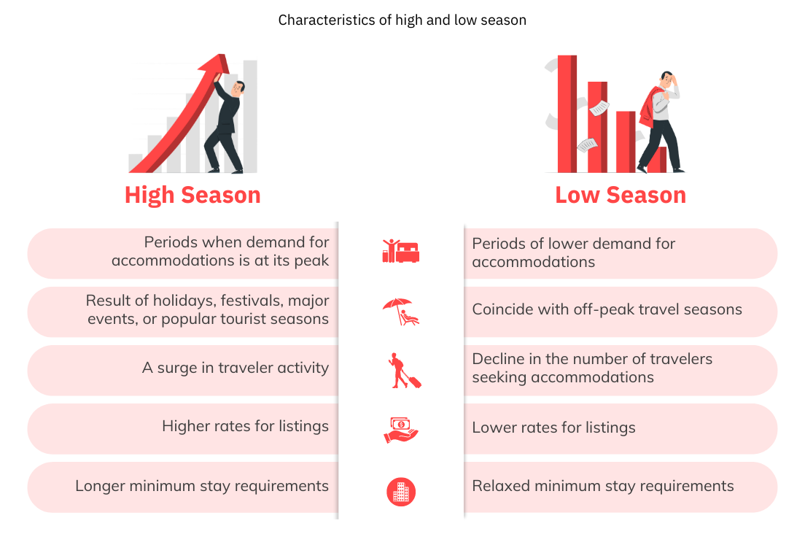
KEY FINDINGS
Pricing Trends
Review Analysis
Availability Insights
Notes:
Pricing Trends confirmed the hypothesis that in Manhattan the prices is higher compared to other boroughs, Review Analysis Entire home/apartment listings receive more reviews than private rooms, Availability Insights Listings with higher prices tend to have lower availability.

Slide 13
Challenge
Dataset is quite old and could be non-representative of the time.
Limited data points could contain bias.
Deeper analysis would reveal clearer insight. Time and knowledge constraints.

Slide 14
THANK YOU!

